Slide 1
Review Analysis on Lifebuoy Sanitizer
Team-2
Tejas
Sumit
Souvik
Kiran
Radhika
Revathi
Mentor
Varun
Karan

Slide 2
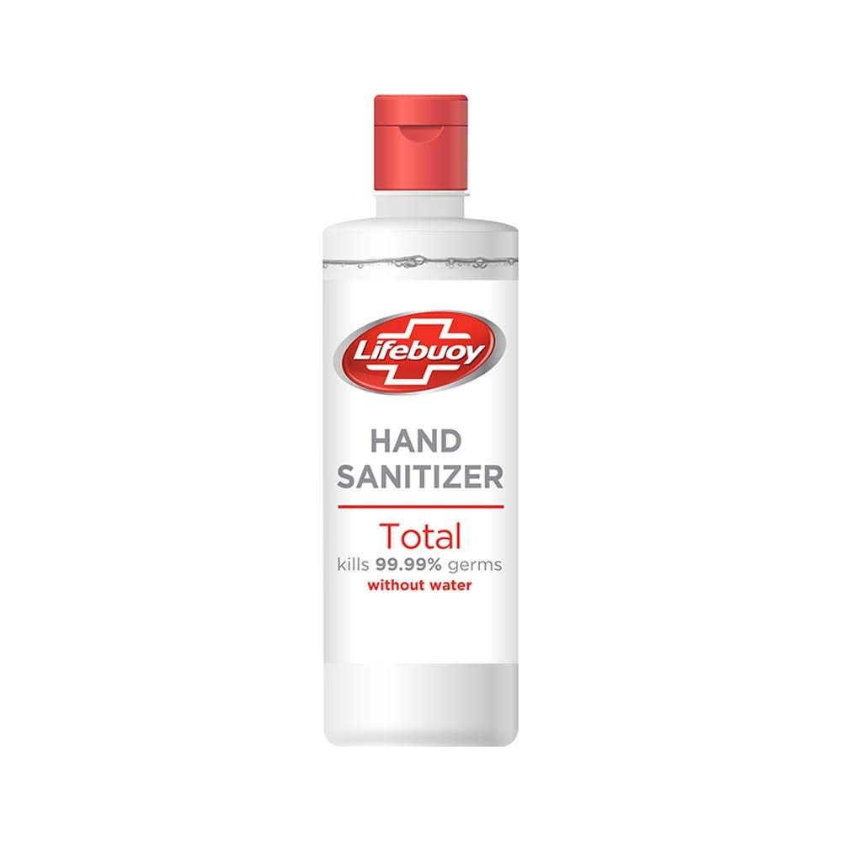
Lifebuoy Alcohol Based Germ Protection Hand Sanitizer
Lifebuoy Hand Sanitizer is an effective, ethyl-alcohol based hand sanitizer (95% v/v), which kills 99.99%of germs, including the deadly H1N1 virus WITHOUT WATER. Added moisturizers and Vitamin E, make it tough on germs, yet gentle on hands, keeping the skin healthy and supple.

Slide 3
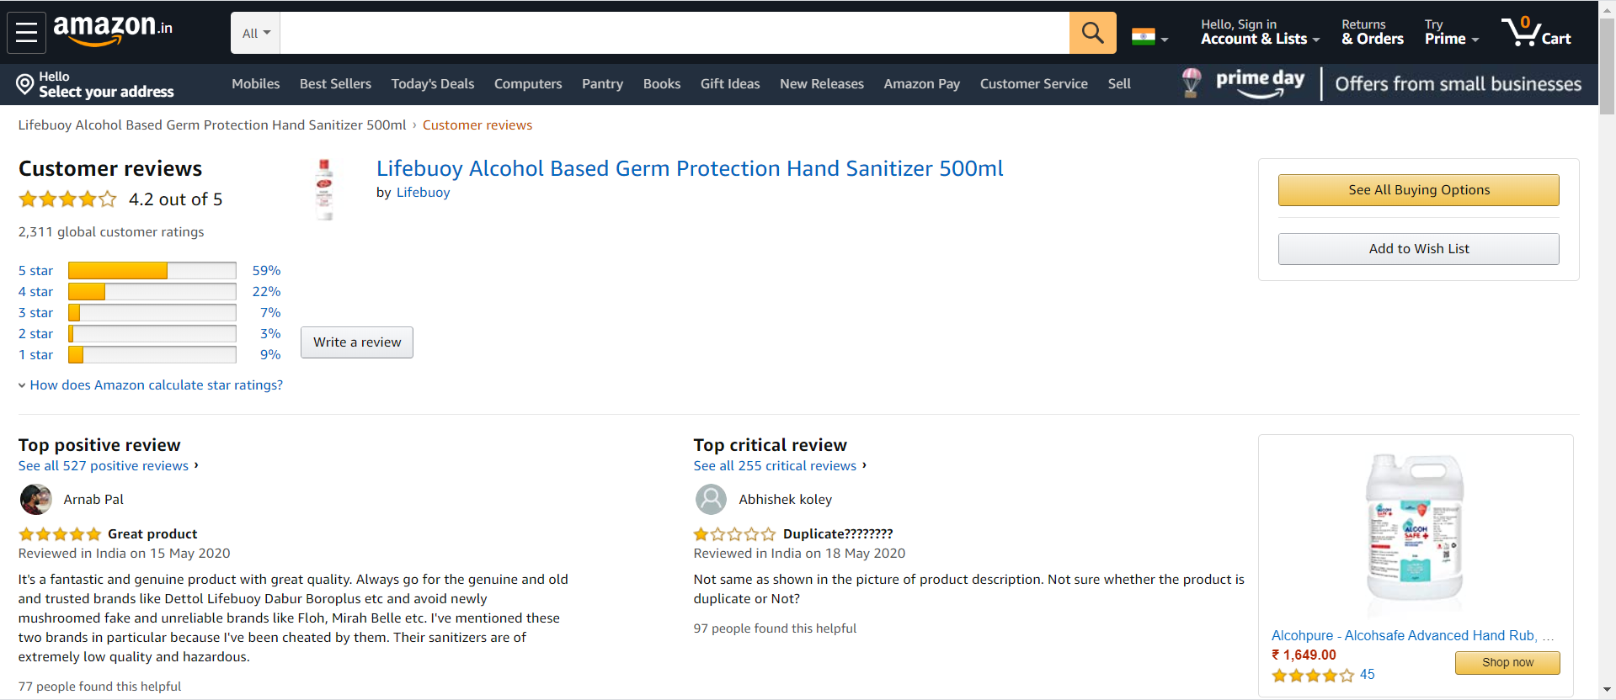
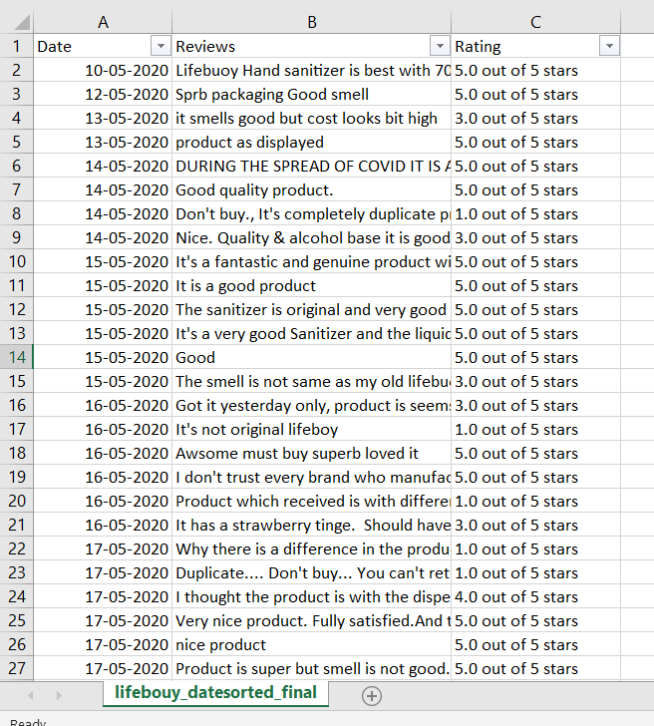
Reviews data with date from Amazon

Slide 4
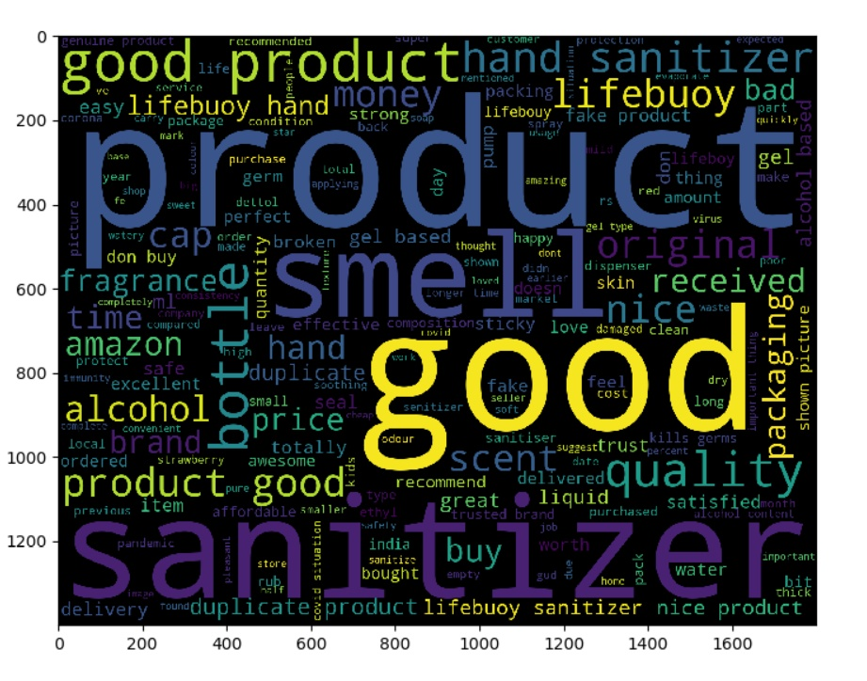
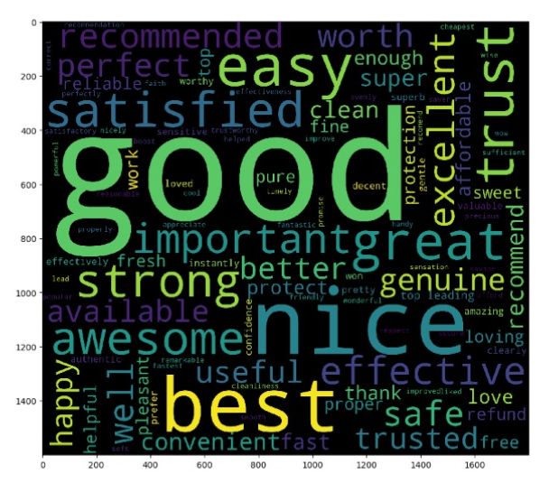
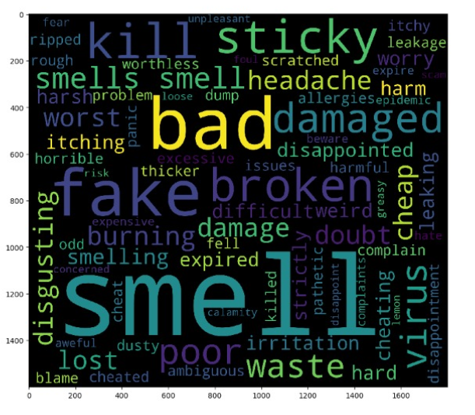
Word Clouds
Word Cloud
Positive Word Cloud
Negative Word Cloud

Slide 5
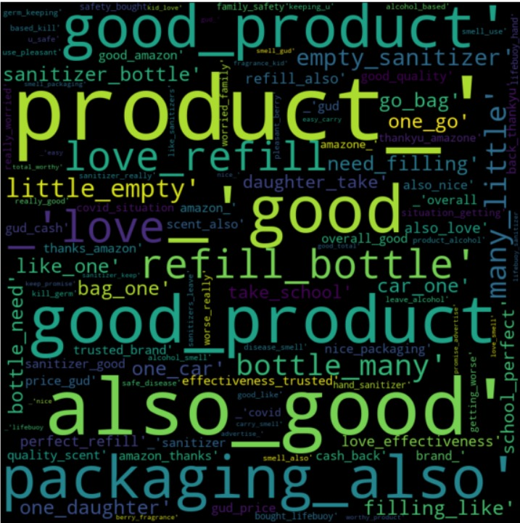
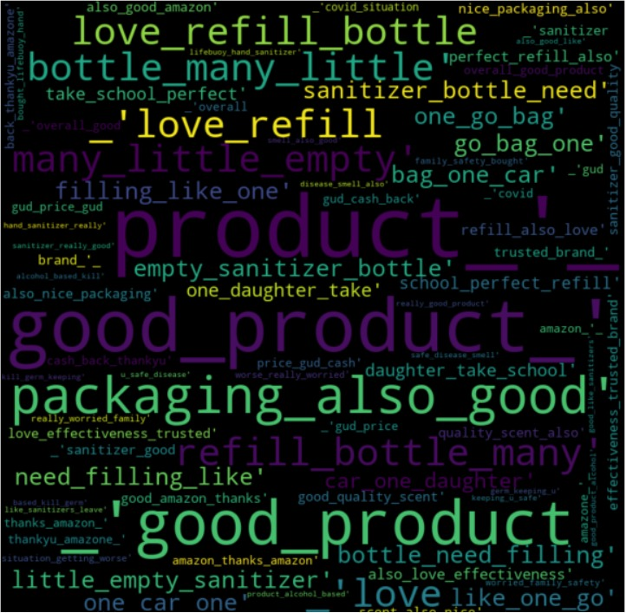
Bigram and Trigram of wordclouds in 3 months
BIGRAM
TRIGRAM
A bigram makes a prediction for a word based on the two words, and a trigram makes a prediction
for the word based on the three words .

Slide 6
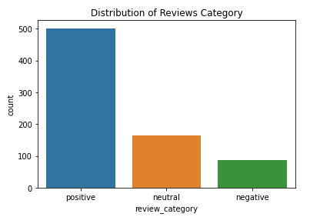
Distribution of Reviews Category

Slide 7
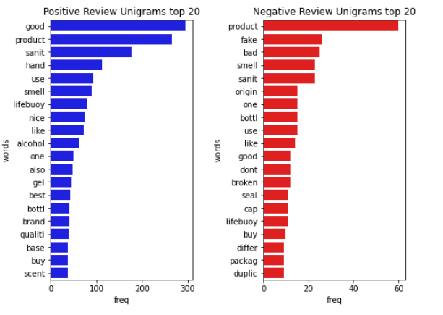
Unigrams of Positive & Negative Reviews

Slide 8
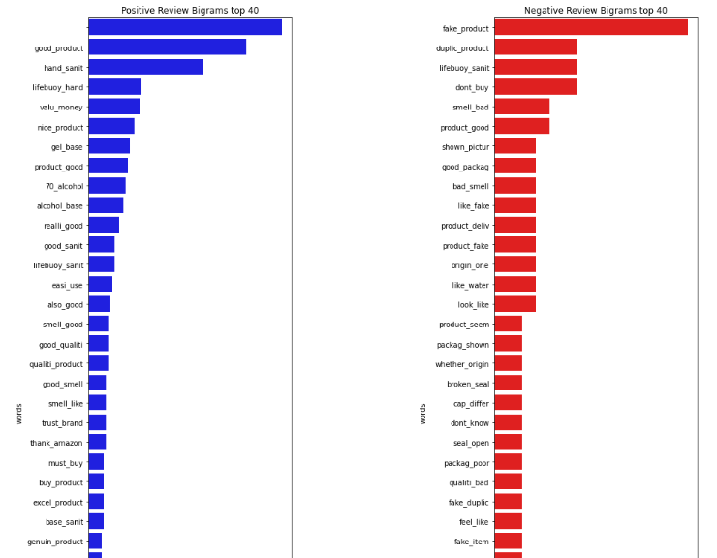
Bigrams of Positive & Negative Reviews

Slide 9
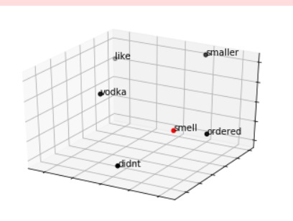
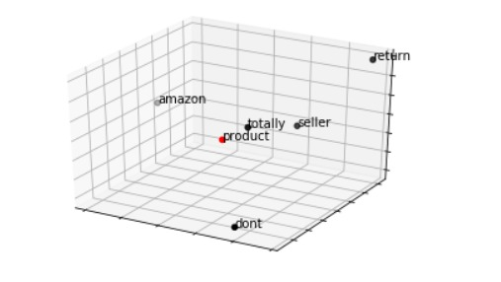
Most Associated Words

Slide 10
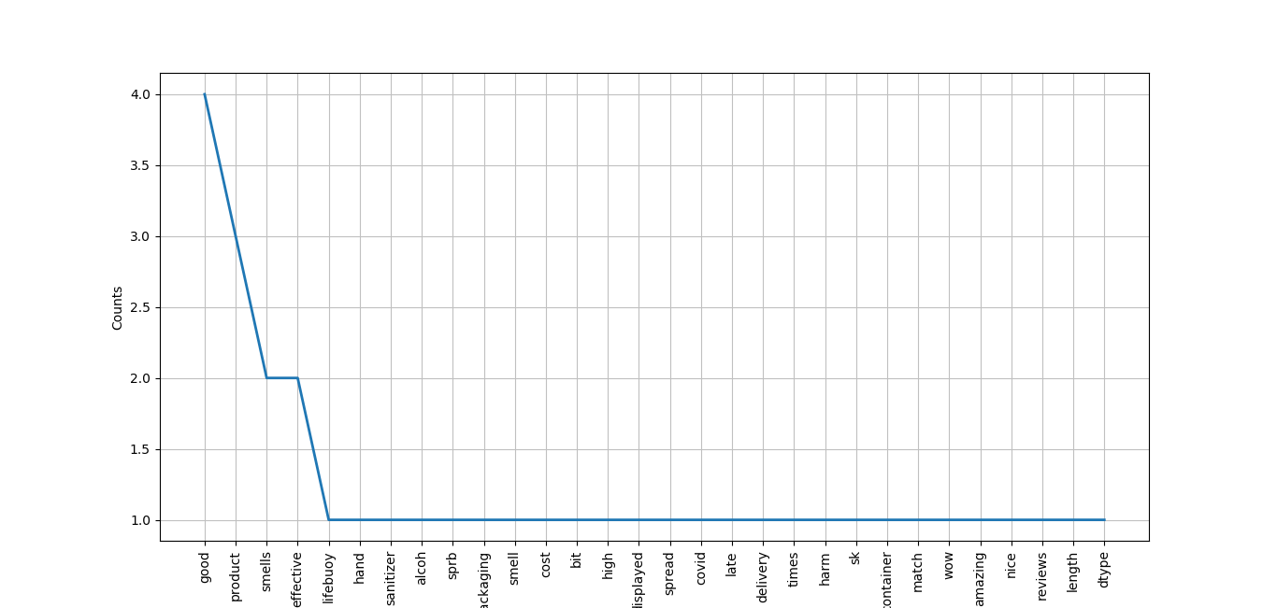
Word frequency distribution plot

Slide 11
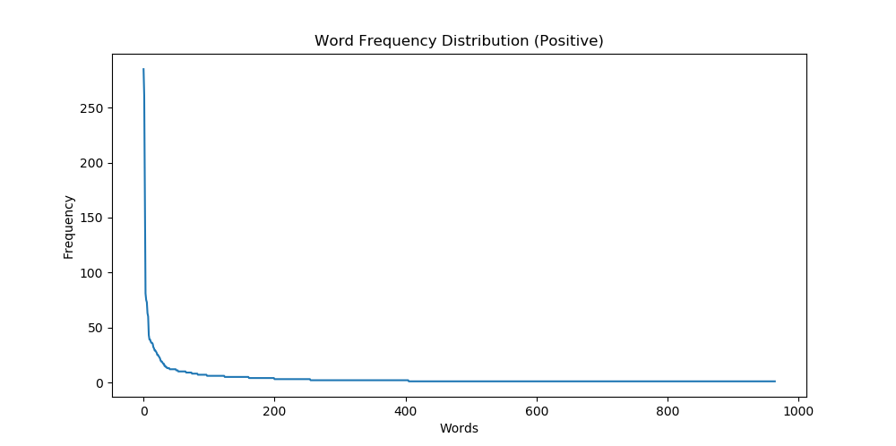
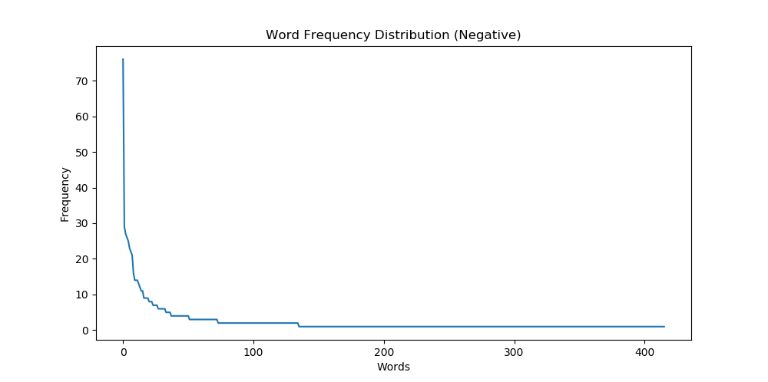
Word Frequency Positive and Negative Plots

Slide 12
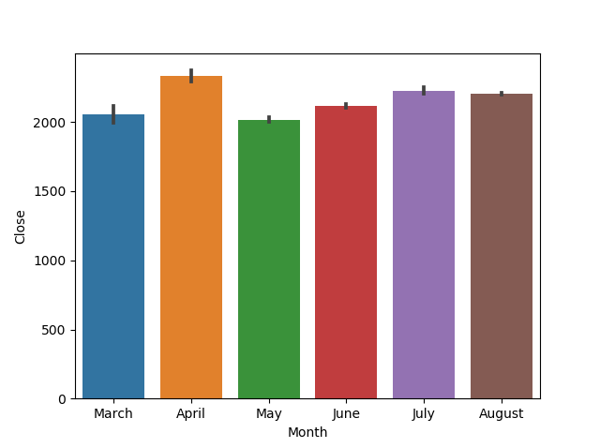
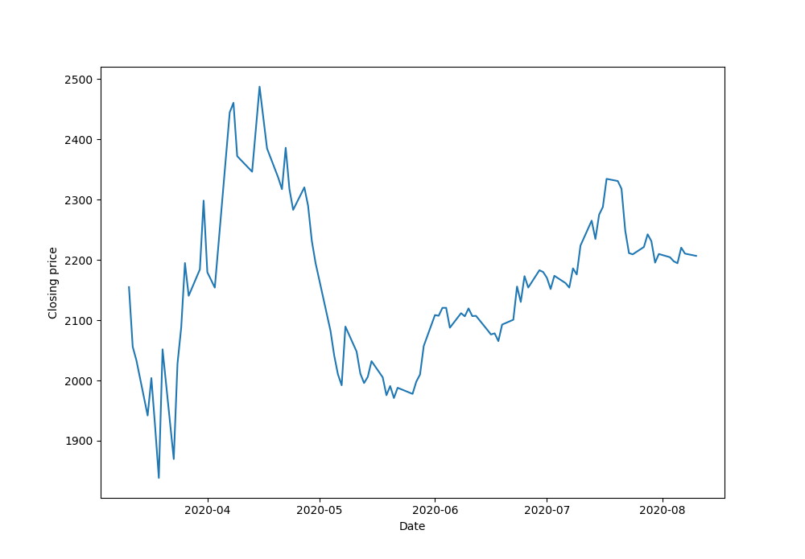
HuL Stock Price Plots

Slide 13
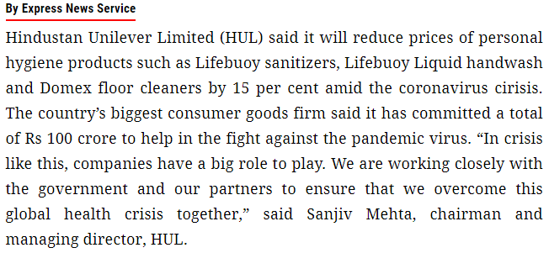
Price reduction by HUL from 21st May

Slide 14
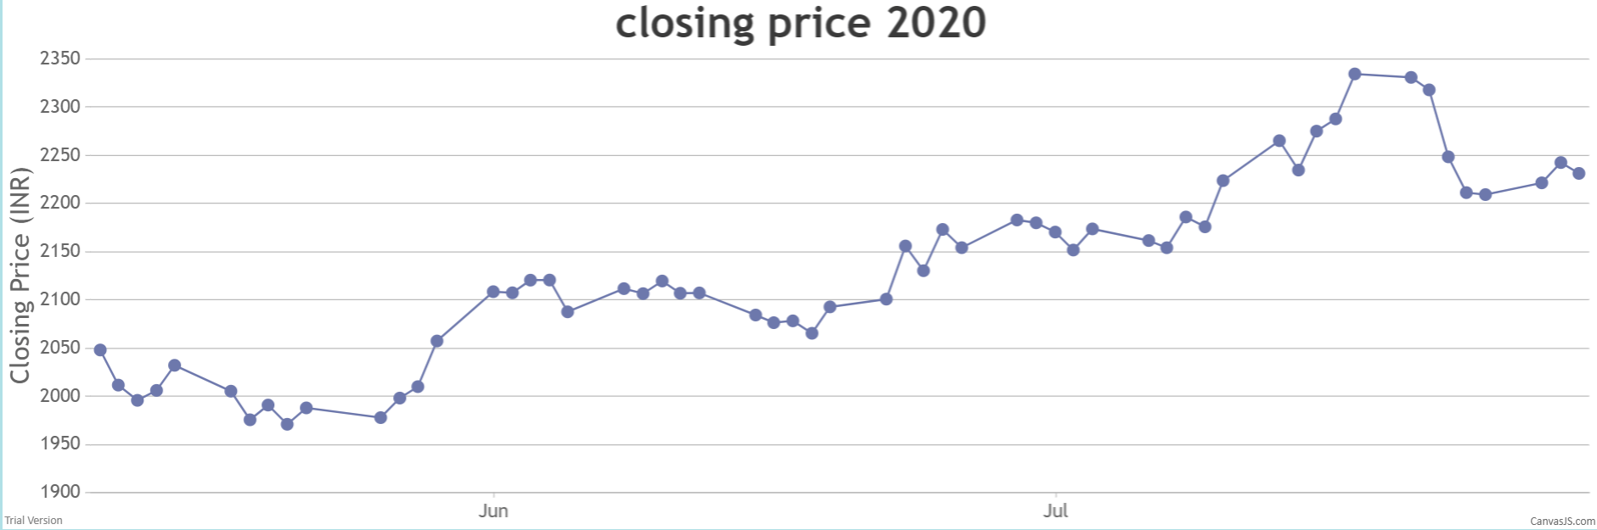
Closing price

Slide 15
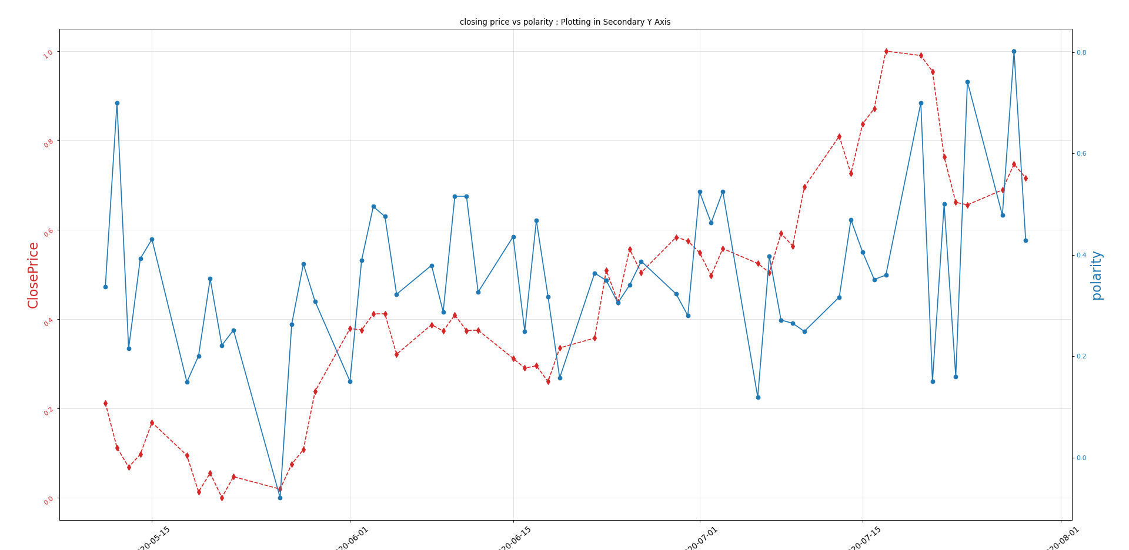
Closing price[min max scaled ] vs polarity

Slide 16
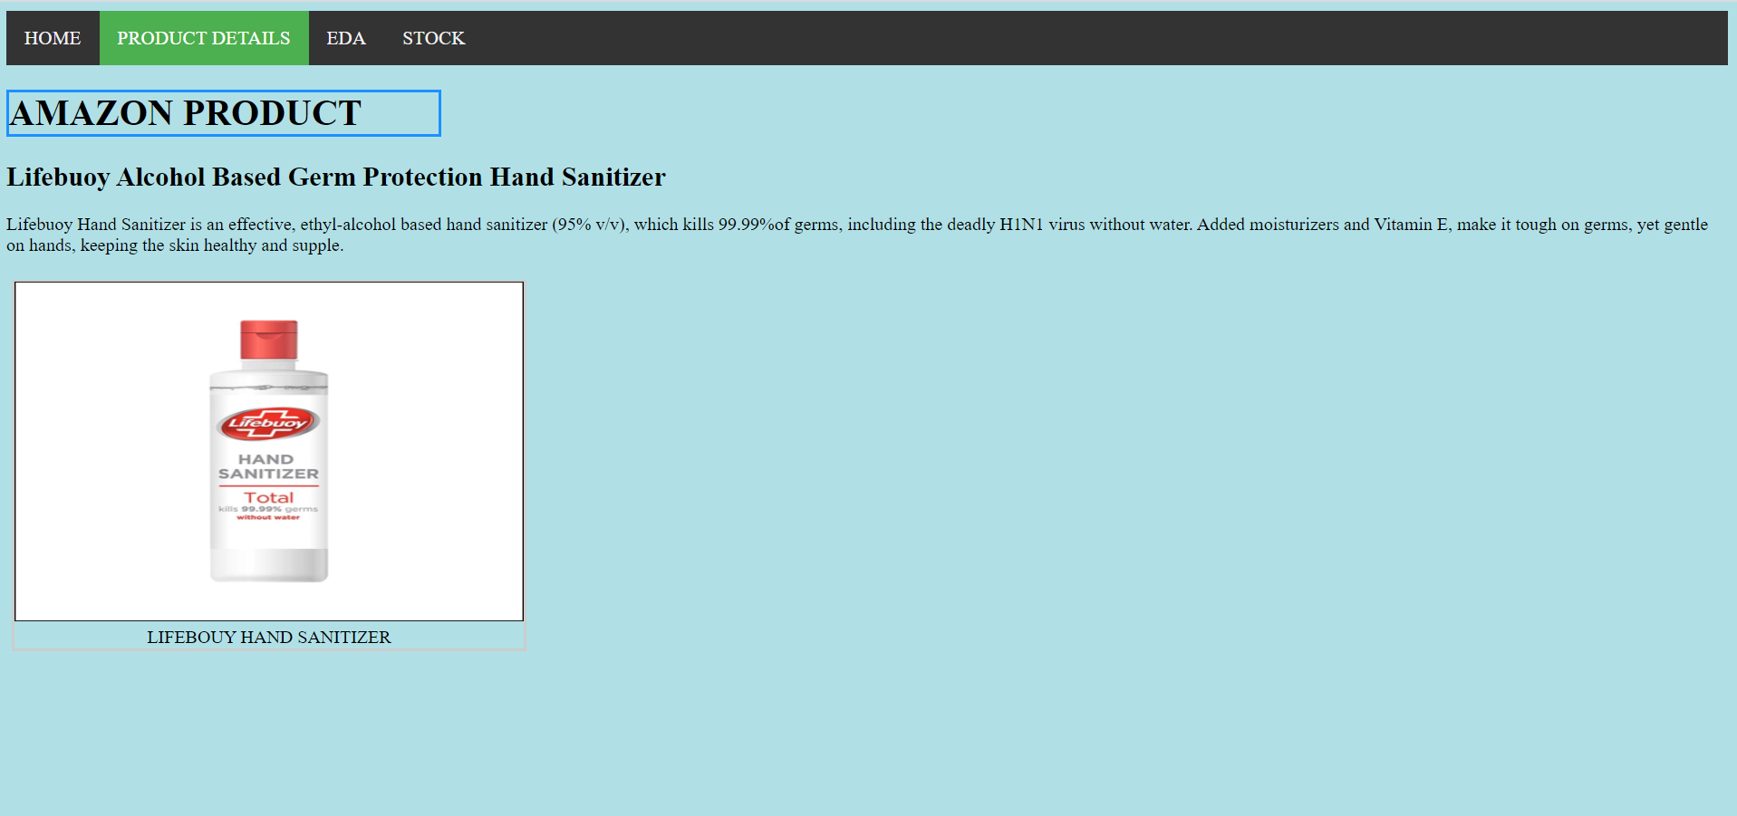
FLASK APPLICATION

Slide 17
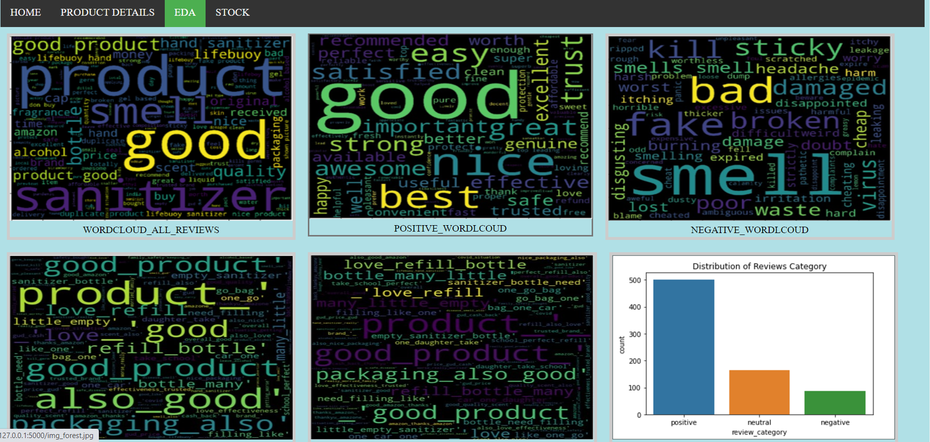

Slide 18
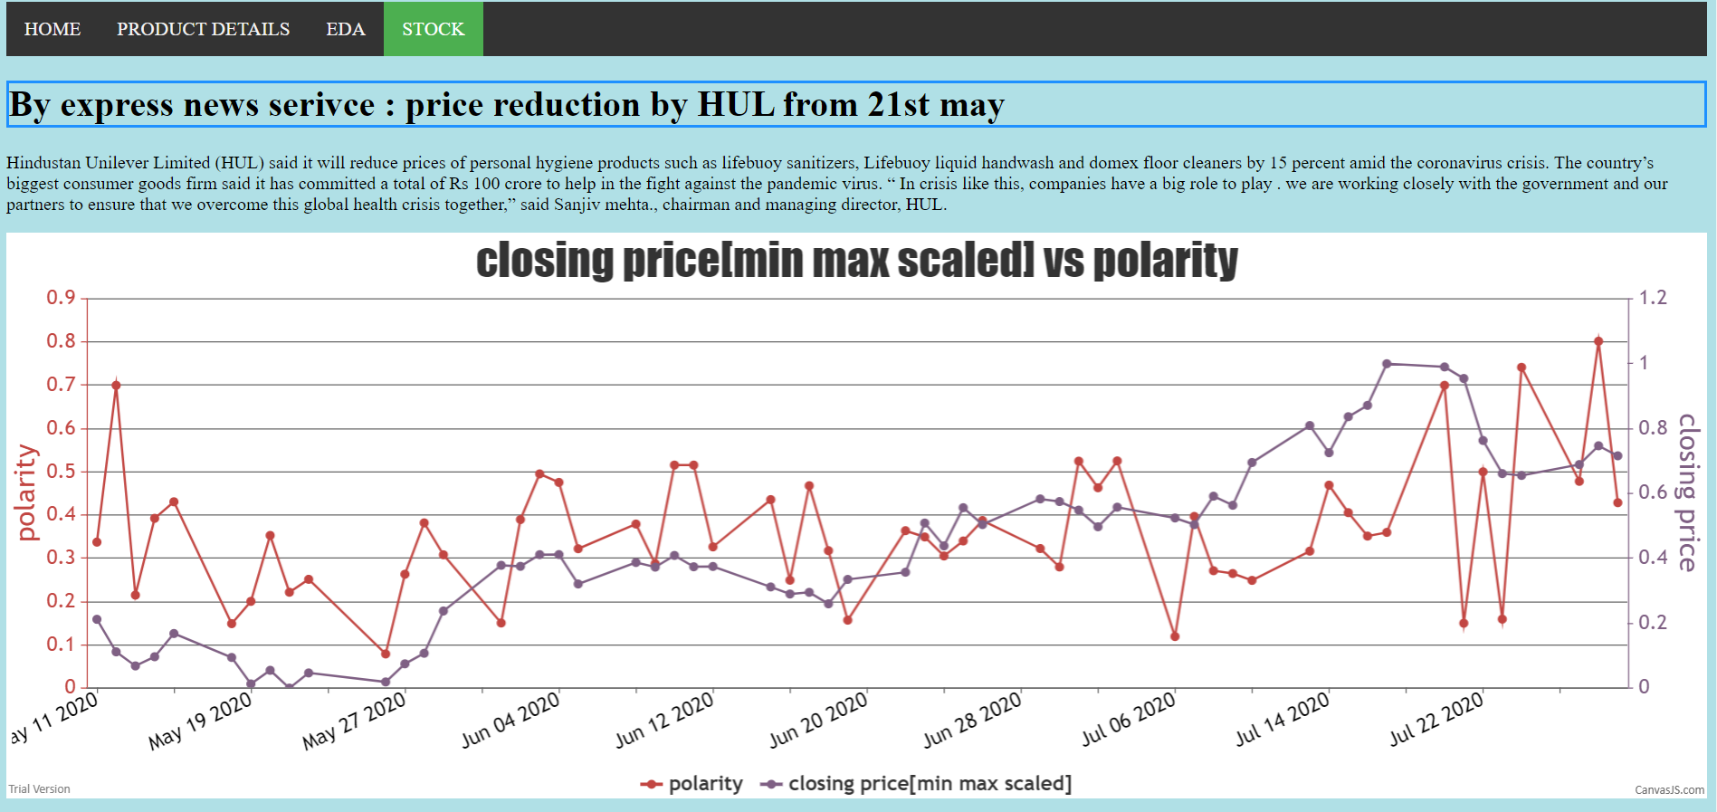

Slide 19
conclusion
Both polarity (average ) and closing price line graph show similar trend.
From may 21 graph has a increasing trend [ HUL has reduced its it’s some of product cost by 15%]
Moreover, the results of analysis reveals that share prices of HUL shows signs of good performance during pandemic period.
Challenges Faced During The Project
1)Reviews extraction from Amazon.
-- fixed with BeautifulSoup, Requests, also tried with web scraping
2)Recognize the emotions behind the word in unigrams.
3)Matching the reviews with stock markets dates.
4)Deploying the model with flask.
5)Facing some problem with Heroku [ package’s installation]
MOST OF PROBLEMS SOLVED WITH DISCUSSING WITH TEAM MEMBERS and some research.

Slide 20
THANK YOU
GitHub link -- https://github.com/KBC1997/AMAZON-NLP-PROJECT.git
-- https://github.com/KBC1997/AMAZON-NLP-FLASK.git

